Slide 1


How Much Would I Pay?
Team Members:
Xinyi Gong, Lanyu Shang, Yang Sun

Slide 2
Overview

Slide 3

Overview

Slide 4
Statistics
100 Million Users (7/2016)
0.64 Million Hosts (11/2014)
2.3 Million Listing (7/2016)
191 Countries (6/2016)
San Francisco: 25.1 million visitors in 2016
San Francisco Airbnb guest: visits for 5.5 days and spends $1,045.
Source:
http://expandedramblings.com/index.php/airbnb-statistics/
http://www.sftravel.com
http://blog.airbnb.com/economic-impact-airbnb/#san-francisco

Slide 5
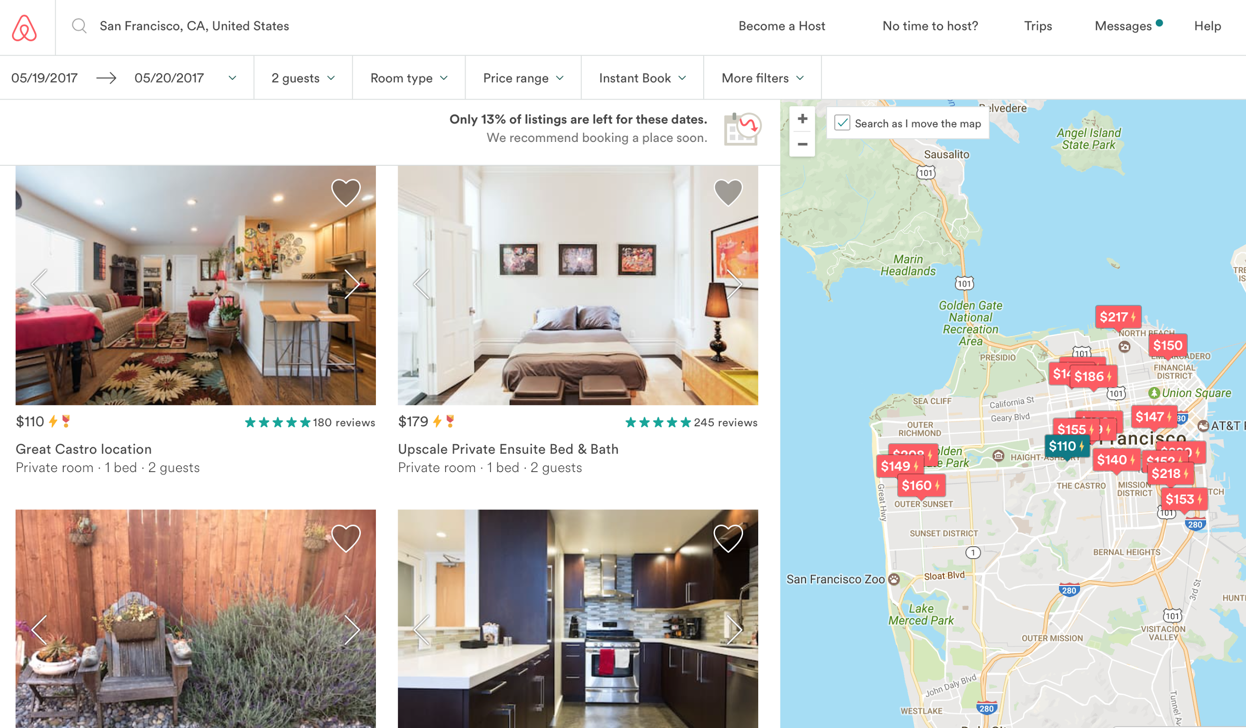
Sample Search

Slide 6
Role & Problem

Slide 7
Role & Problem:
Role: Guest
Problem: Predicting expected price range for a stay given preference.
Location: San Francisco

Slide 8
Data

Slide 9
Data Overview
“listing.csv”: 8720 listings and 95 variables.
Target Variable: “price”
Intuitively, 33 predicting variables are selected.
Nominal: "id", "host_id", "host_response_time", "property_type", "room_type", "bed_type", "cancellation_policy“
Binary: "host_is_superhost", "host_has_profile_pic", "host_identity_verified" "is_location_exact", "instant_bookable“
Continuous: "bathrooms", "bedrooms", "beds", "host_response_rate", "host_listings_count", "latitude", "longitude", "security_deposit", "guests_included", "extra_people", "minimum_nights", "availability_365", "review_scores_rating", "review_scores_accuracy", "review_scores_cleanliness", "review_scores_checkin", "review_scores_communication", "review_scores_location", "review_scores_value", "calculated_host_listings_count", "reviews_per_month"

Slide 10
Pre-processing
Remove 11 empty entries.
Replace NA:
With Mean: “host_response_rate”, 7 review score related variables
With Zero: "bathrooms", "bedrooms", "beds", "reviews_per_month", "security_deposit"
With a New Category: “host_response_time”

Slide 11
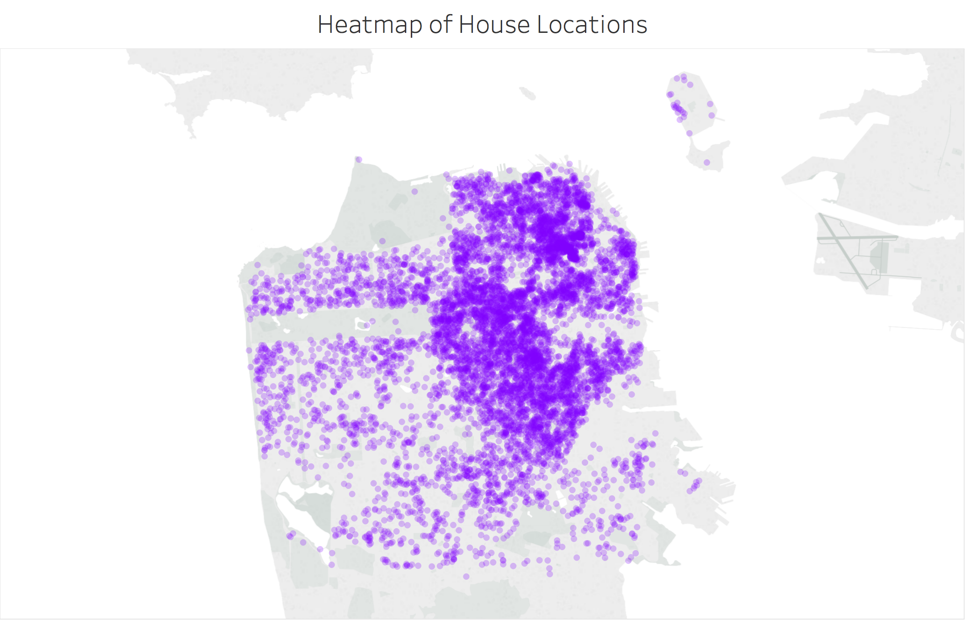
Visualization of Listing Locations

Slide 12
Bivariate Analysis

Slide 13
About Booking
“instant_bookable”: whether the listing can be booked immediately without the approval of hosts.
“cancellation_policy”: what will happen if guests want to cancel the booking
“security_deposit”: deposit required to secure the stay (e.g., property damage)
Intuition: listings with higher price may have higher quality and more regulations: not instantly bookable, strict cancellation policy or greater security deposit.

Slide 14
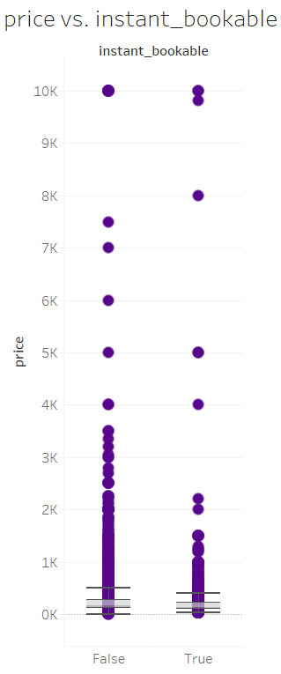
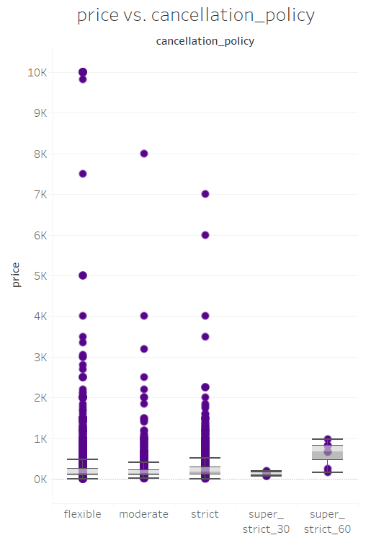
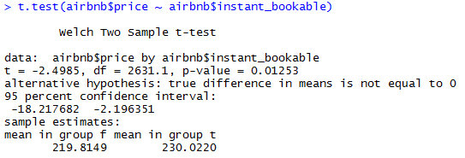
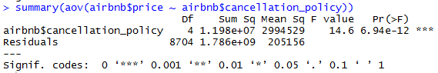

About Booking (cont.)
Instant Bookable?
Cancellation Policy

Slide 15
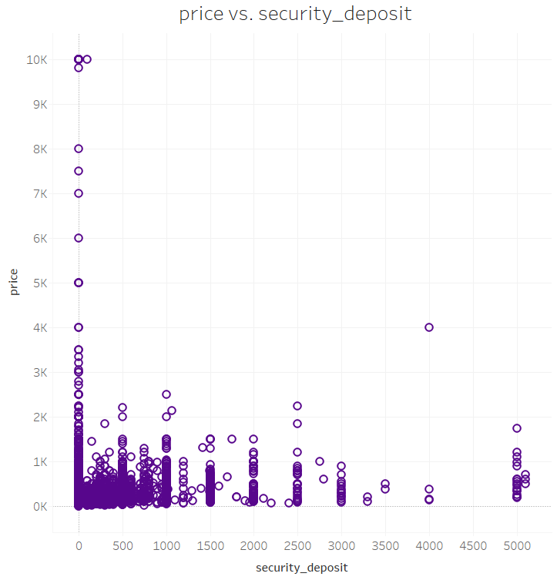
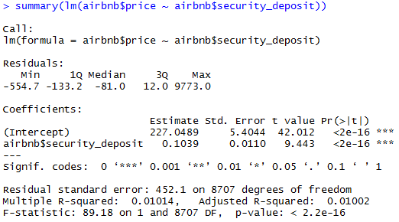
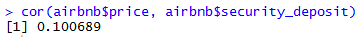
About Booking (cont.)
Security Deposit

Slide 16
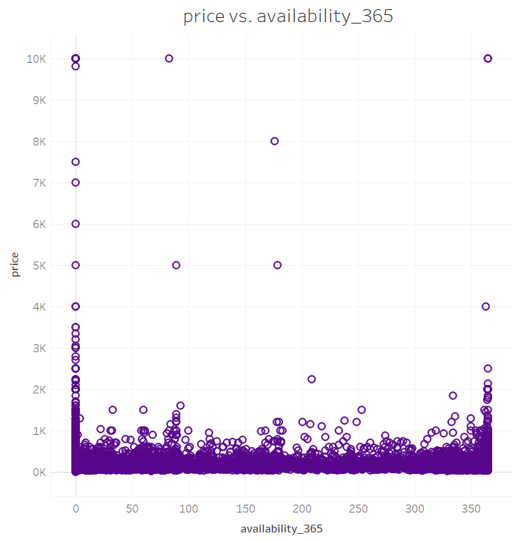
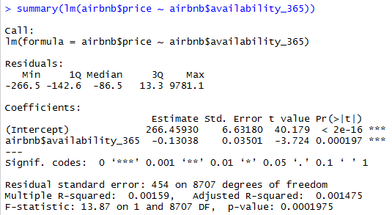
Availability
“availability_365”: how many days in a year will the listing ready to be booked
Intuition: listings with low availability (either booked or occupied) reflect a high demand and is expected to have higher price.

Slide 17
About Hosts
“host_response_time”: how long will the host reply the message.
“host_is_superhost”: whether the host is qualified as a superhost*.
“host_identity_verified”: whether the identity of hosts is verified.
“calculated_host_listing_count”: the number of listings of a host.
Intuition: well-qualified hosts are expected to provide great service which may further affect the price, for example, a super-host is expected to know the market better and thus the price should be more reasonable.
*Superhosts:
complete at least 10 trips in their listings in a year;
respond to guests quickly and maintain a 90% response rate or higher;
provide listings that inspire enthusiastic reviews (At least 80% of their reviews need to be 5 stars);
rarely cancel the reservation.

Slide 18
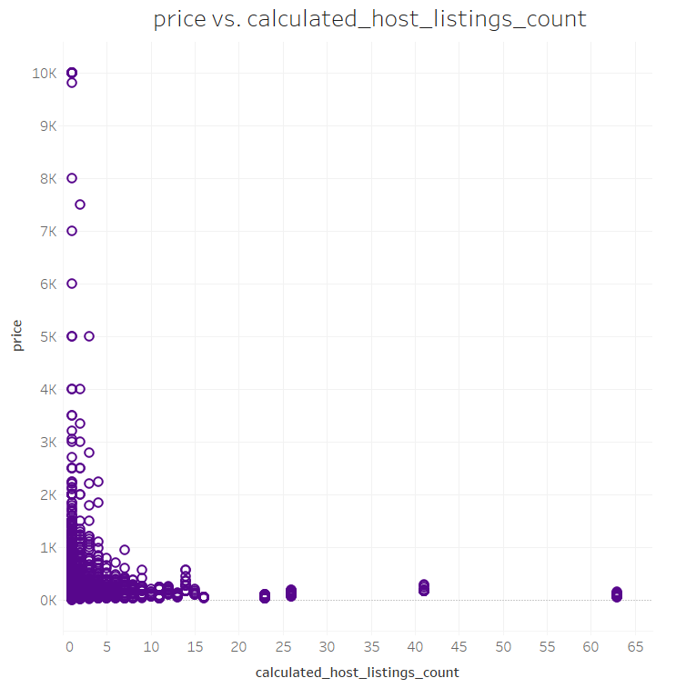
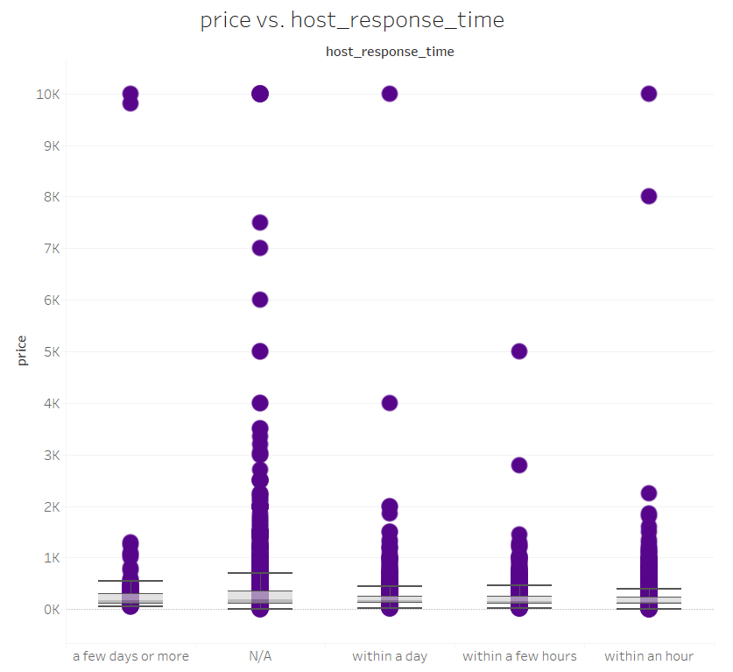
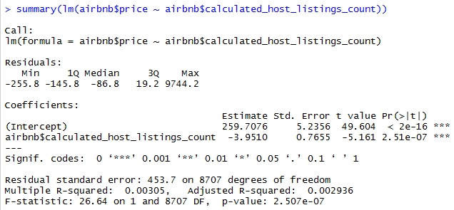
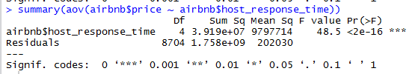
About Hosts (cont.)
Host Response Time
Host Listing Count

Slide 19
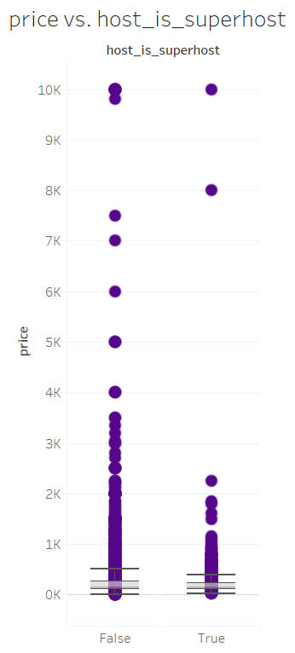
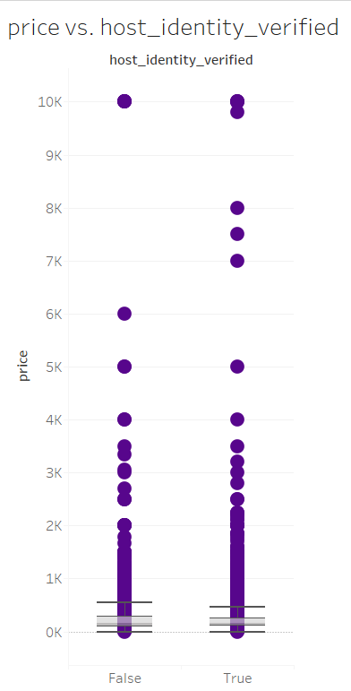
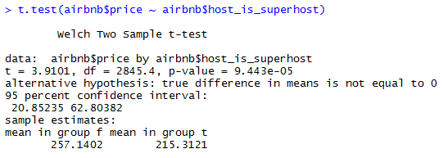
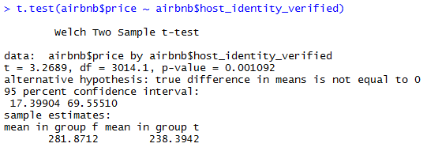
About Hosts (cont.)
Superhost?
Identity Verified?

Slide 20
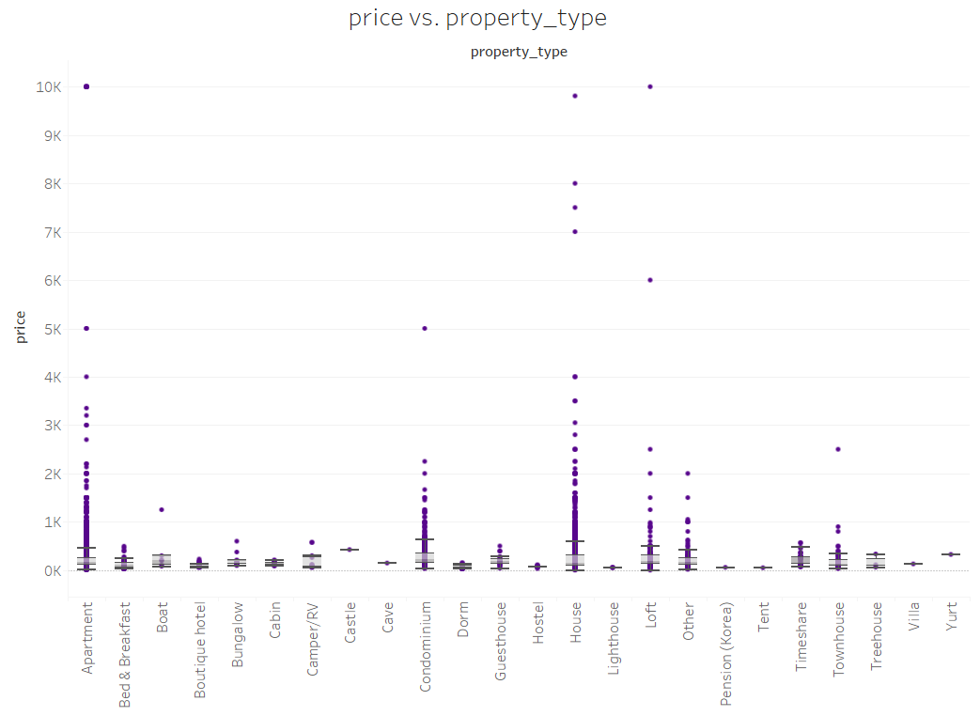
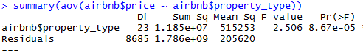
Property Type
“property_type”: type of the listing
Intuition: different types can affect the price, e.g., castle is more expensive than tent.

Slide 21
Room Properties
“room_type”: type of rooms
“bathrooms”: number of bathrooms in the listing
“bedrooms”: number of bedrooms in the listing
“beds”: number of beds in the listing
“bed_type”: type of beds in the listing
“guests_included”: number of guests the listing supposes to hold
Intuition: all above variables reflect the listing size and condition, which can affect the price. The bigger and better-condition listings are tended to have higher prices than the smaller ones.

Slide 22
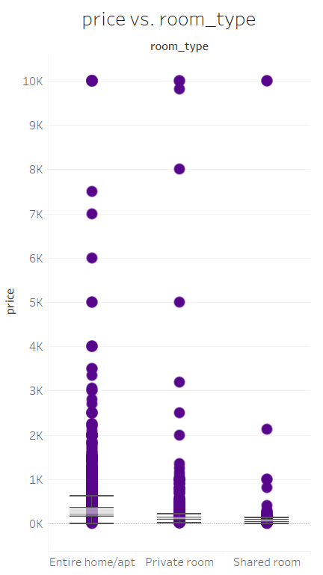
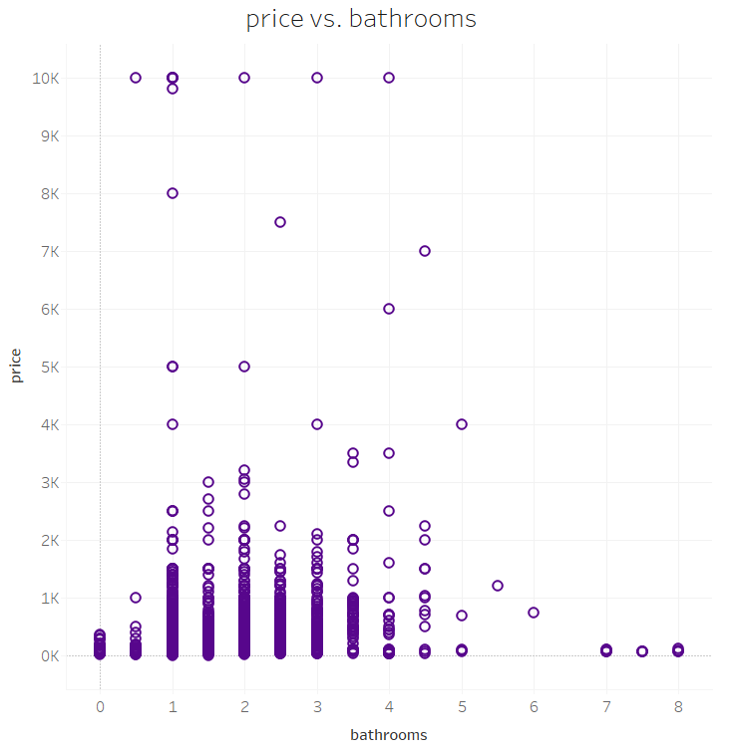
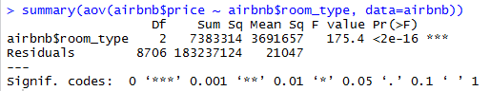
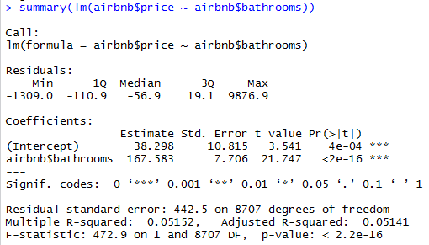
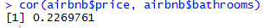
Room Properties (cont.)
Room Type
# of Bathrooms

Slide 23
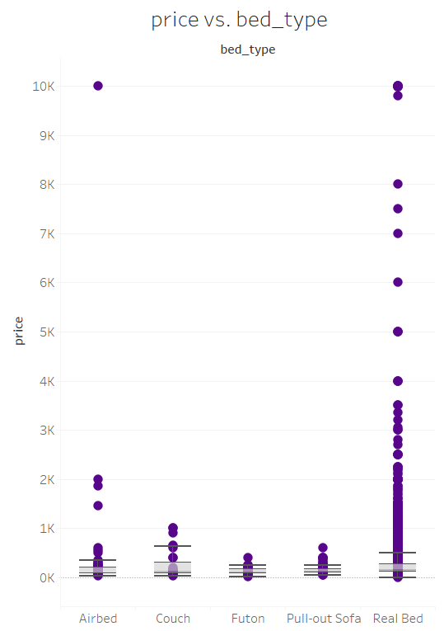
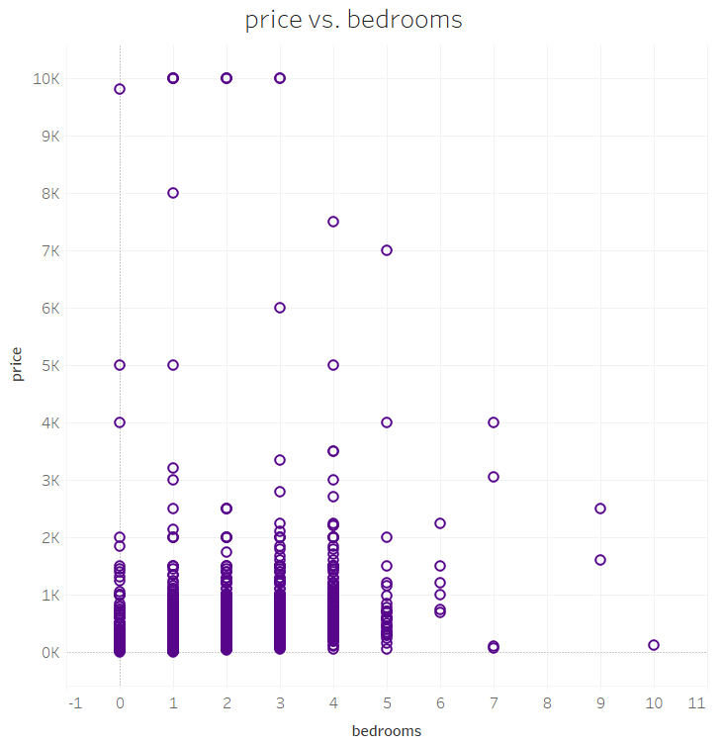
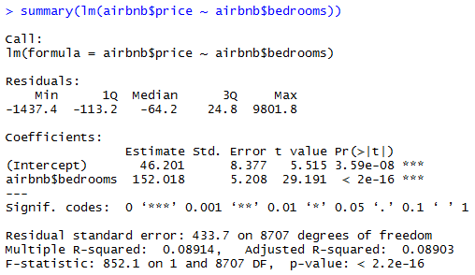
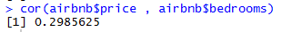
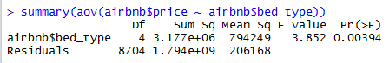
Room Properties (cont.)
# of Bedrooms
Bed Types

Slide 24
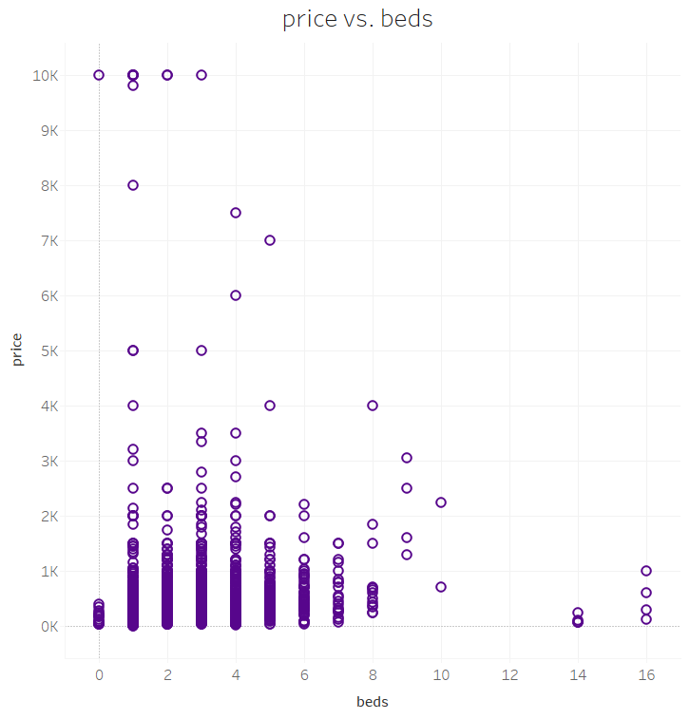
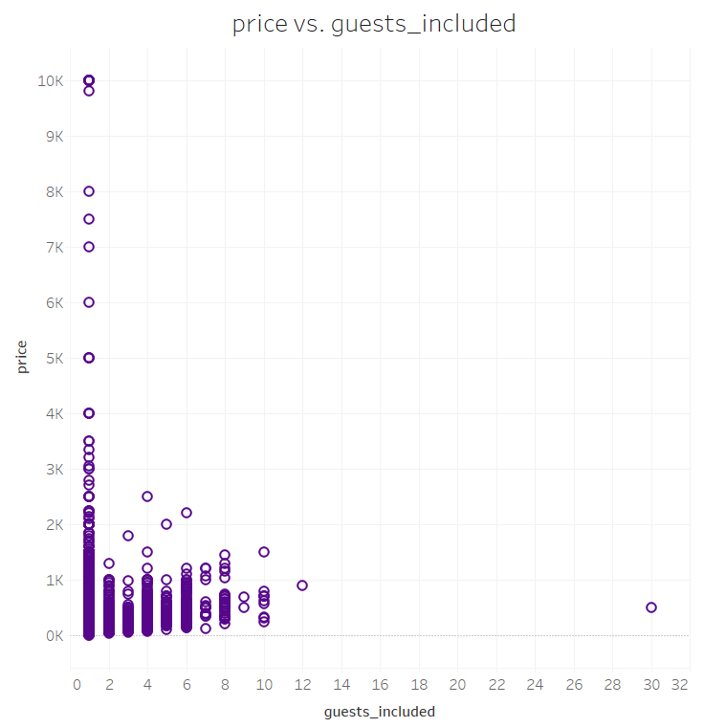
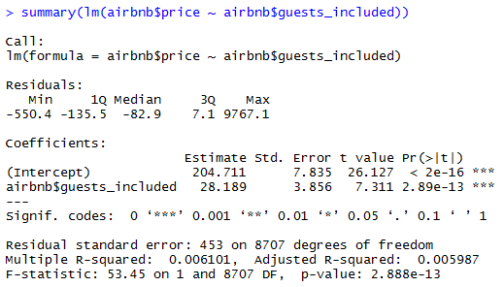
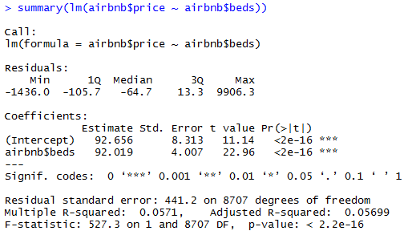
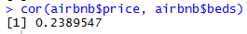
Room Properties (cont.)
Guests Included
# of Beds

Slide 25
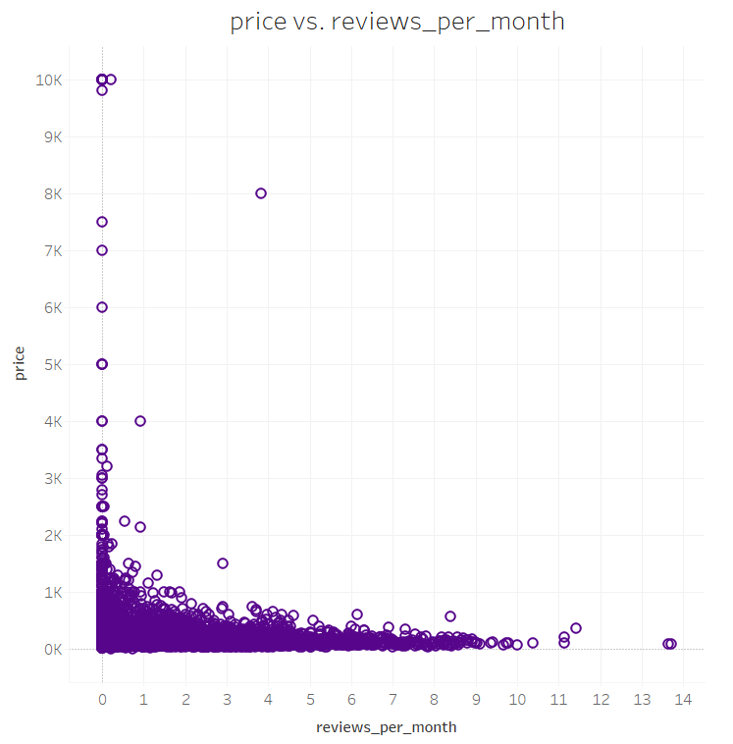
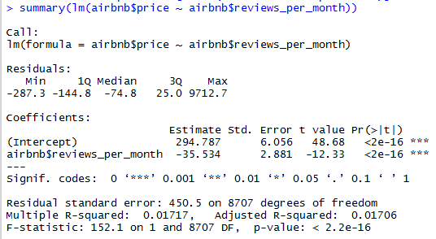
Reviews/month
“reviews_per_month”: number of reviews received per month
Intuition: a reasonably priced listing is expected to be more popular and thus to receive more reviews per month.

Slide 26
Review Scores
Variable Name | Description | p-value of Linear Model | Correlation
“review_scores_rating” | overall rating of stay | 1.797e-05 | 0.04593894
“review_scores_accuracy” | the accuracy of listing description | 0.006464 | 0.02917963
“review_scores_cleanliness” | the cleanliness of listing | 0.0005223 | 0.03716541
“review_scores_checkin” | the check-in process | 0.04402 | 0.0215808
“review_scores_communication” | the communication with hosts | 0.02993 | 0.02326415
“review_scores_location” | the location of listing | 0.0008218 | 0.03584101
Intuition: a listing with higher review is expected to have higher price as it reflects the good quality and service.

Slide 27
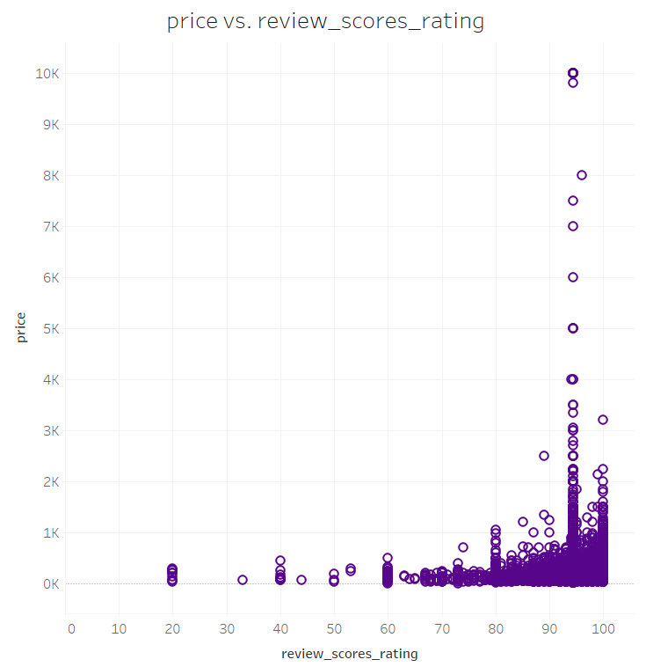
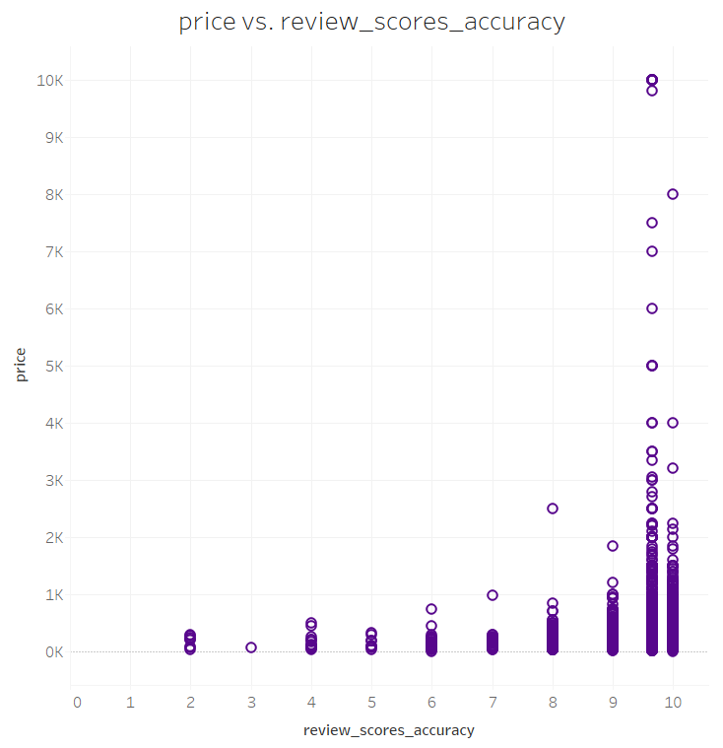
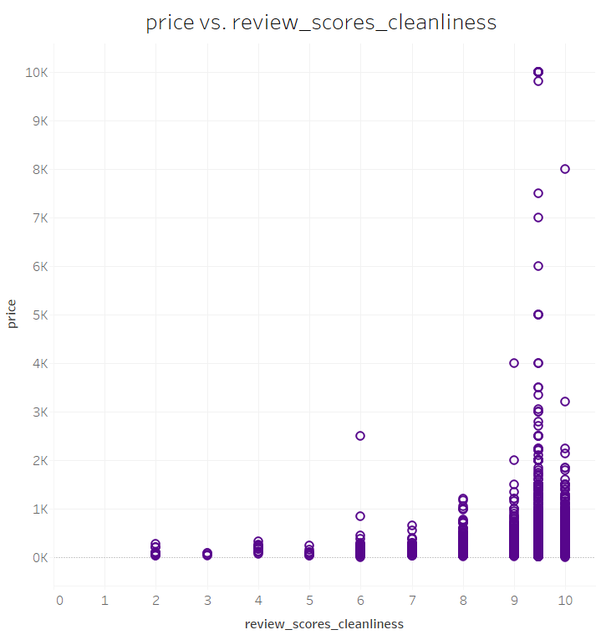
Review Scores (cont.)

Slide 28
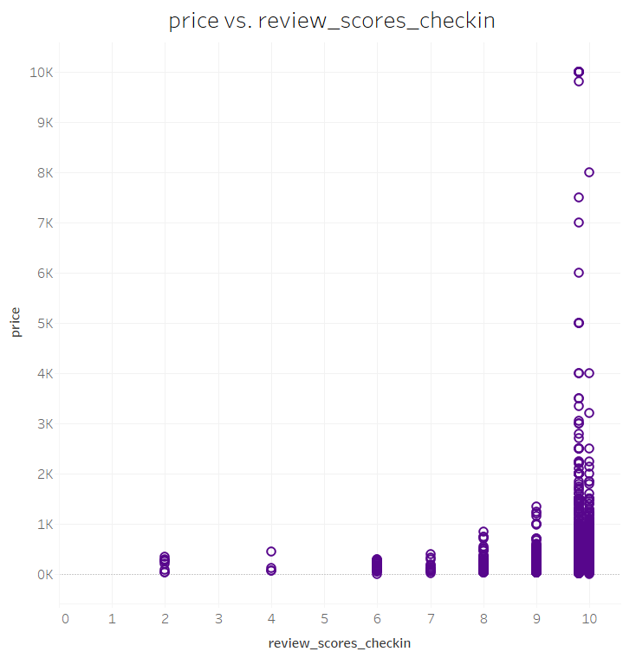
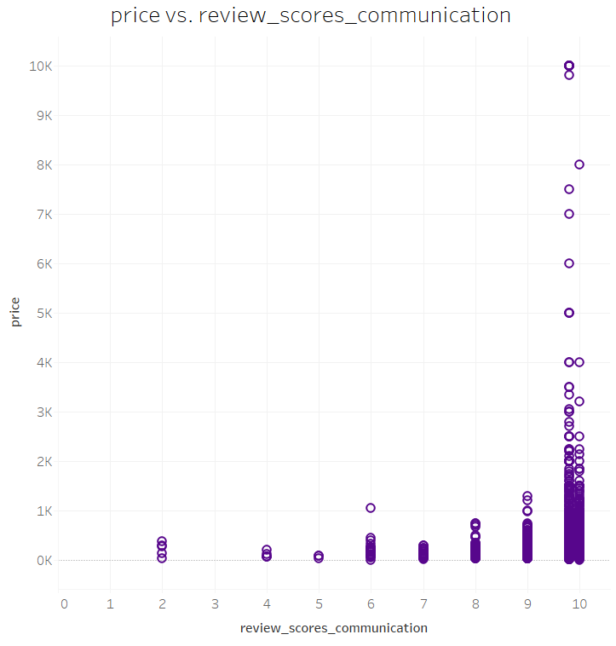
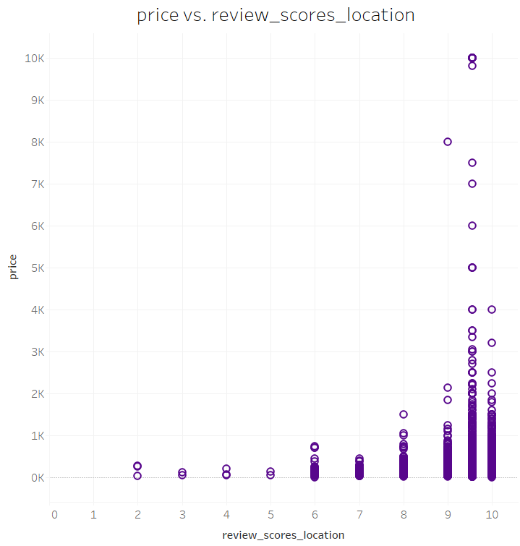
Review Scores (cont.)

Slide 29
Potential Predictors for “price”
room_type
instant_bookable
host_response_time
host_is_superhost
host_identity_verified
property_type
bathrooms
bedrooms
beds
bed_type
security_deposit
guests_included
availability_365
review_scores_rating
review_scores_accuracy
review_scores_cleanliness
review_scores_checkin
review_scores_communication
review_scores_location
cancellation_policy
calculated_host_listings_count
reviews_per_month

Slide 30
Regression

Slide 31
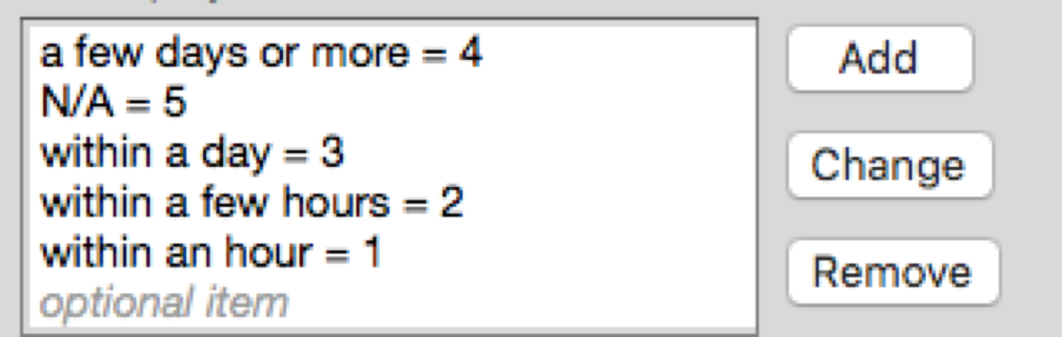
Value Labels
For example: host_response_time

Slide 32
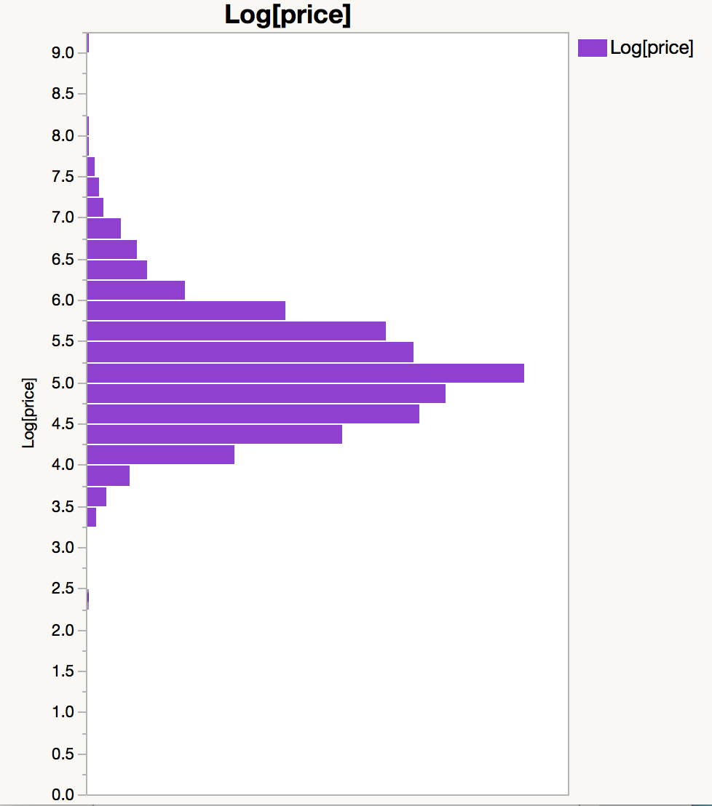
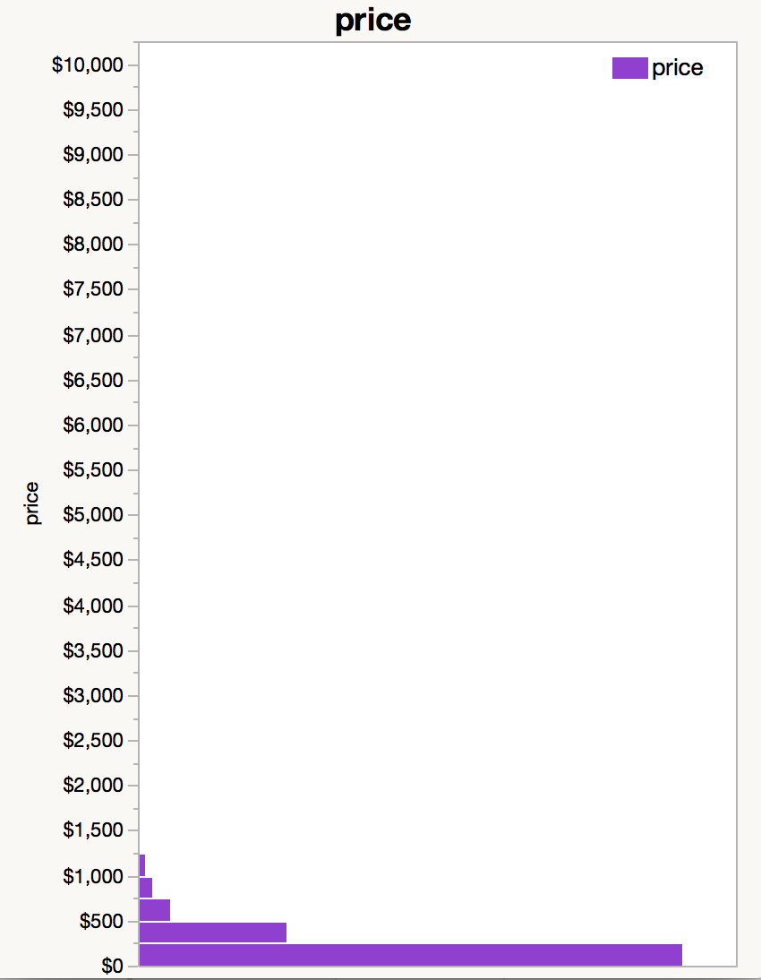
Target Variable
Price
Logged Price

Slide 33
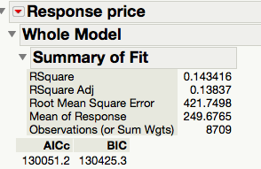
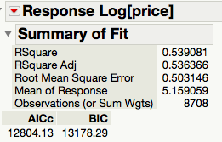
Linear vs Semi-log model
vs

Slide 34
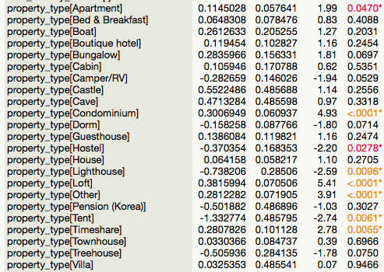
Model Improvement
Look at Indicator function parametrization, almost all of the “property_type” have high p-value:

Slide 35
Nominal Variables
Some categorical variables are too many levels, which will bias this predictor’s coefficients up.

Slide 36

Feature Deletion
Trade-off: fewer features might decrease model accuracy, but will also decrease model complexity.

Slide 37

Continuous Variables
Some features have similar meanings, and they may also decrease model quality.
e.g.,

Slide 38
Principal component analysis

Slide 39
Factor Analysis
Several predictors have similar meanings.
e.g., 7 “review_scores” , they complicate the model.
We can do PCA to see if we will have a simplified model and a similar model predictive power.

Slide 40


PCA on 7 review scores

Slide 41

Rule of thumb: keep factor that has an e.v > 1
The regression result is
We can see that R-square dropped and AIC/BIC increased, so we should keep some review scores that have low p-values.

Slide 42


back to original Semi-log model
We do see some review scores have high p-value. Let’s see the regression result after dropping them:

Slide 43
Clustering

Slide 44

Dendrogram
Hierarchical Clustering

Slide 45

Outliers
Even though the dataset has been cleaned, there are still several outliers that may affect accuracy of the model.
e.g.,

Slide 46

Exclude and Hide the Outliers

Slide 47

Multivariate Analysis
without outliers

Slide 48

Result of Outliers-Excluded Model
R-square gets improved by 2% and AIC/BICs both decrease by 26%.

Slide 49

Final model features & coefficients

Slide 50

Distribution of Logged Price Without Outliers

Slide 51
Applications

Slide 52
Example
I am a traveler to San Francisco, and I’d like 2 nights’ stay at an apartment on Airbnb, with all full score review, 1 bed, 1 bathroom; I do not need the host to be a super host. But I prefer that the host will reply within a few hours and does not require security deposit.

Slide 53

Result

Slide 54
Expected Price
p = 2 * exp(5.2645) = 2*193 = $386
Note: we use the average value to calculate expected price if the guest does not have a particular requirement for the predictors in the model.

Slide 55
Conclusion
As a guest, we normally have an expected price for accommodation. Using this model, we should first fill in our requirements for stay. For example, what is the room type, what are reviews for the host, etc. Then, we can calculate the expected price per night. If the host price is above the model’s estimated price, we should pick another host, otherwise, the host is an ideal choice for our trip.

Slide 56
Discussion
Model complexity vs model accuracy
Outliers’ negative impact on model quality
Prices’ increase rarely linearly (e.g., flight, soup, etc.). Text mining and other machine learning algorithm might help (in the original dataset, there are many variables that are fully composed of text/characters)

Slide 57
Q & A thank You

